Slide 1
Dominic P.
My year in review

Slide 2
About Me
Love to playing games
Like to go camping
Enjoy Learning about computers and coding

Slide 3
Successes
Blender
GitHub
Tiled/SuperTiledtoUnity

Slide 4
Challenges
Communication with peers about scope creep
Organization
Easily distracted

Slide 5
Personal Satisfaction
Made Isometric levels for the first time
Learn how to use Tiled
Avoided merge conflicts

Slide 6
Career Plans
Continue leaning more coding languages
Game development
Participate in game jams
Or Cyber security

Slide 7
Tri-Tech Advantages/Disadvantages
Advantages:
Long periods
Easy to get help from peers
Meet students with similar interests
Disadvantages:
Sick days
Tours

Slide 8
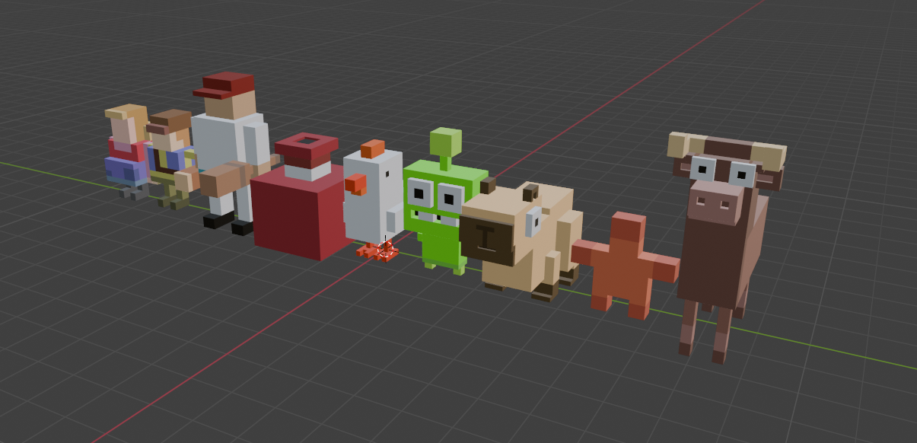
Work Examples

Slide 9
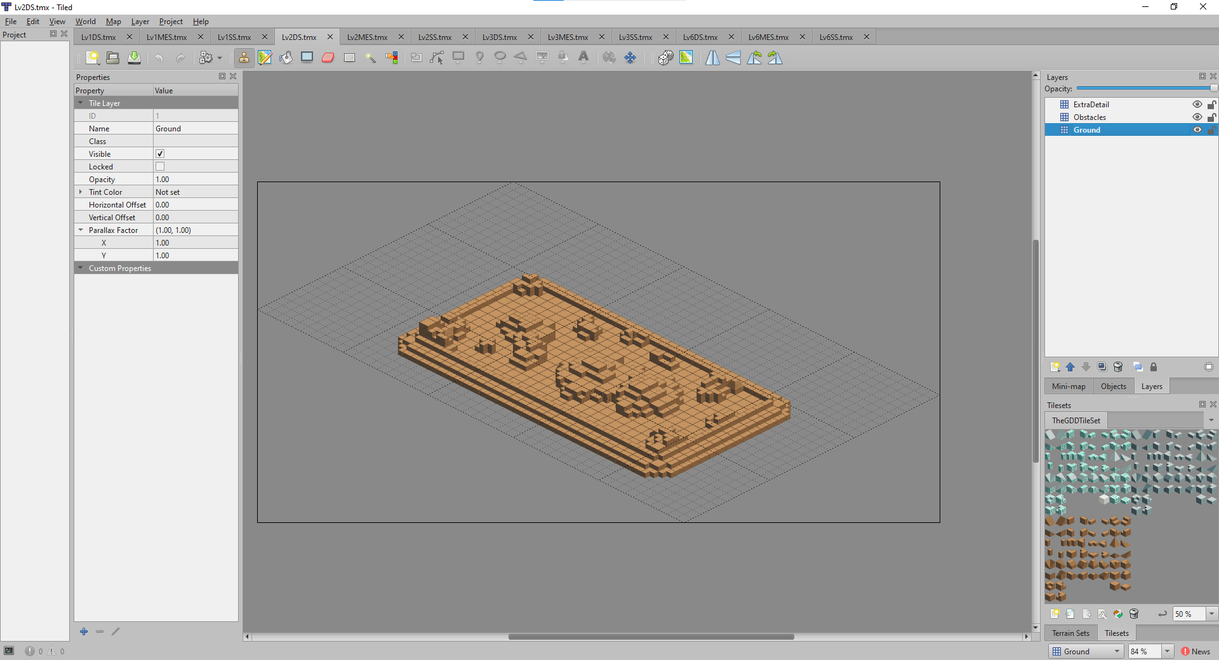
Work Examples

Slide 10
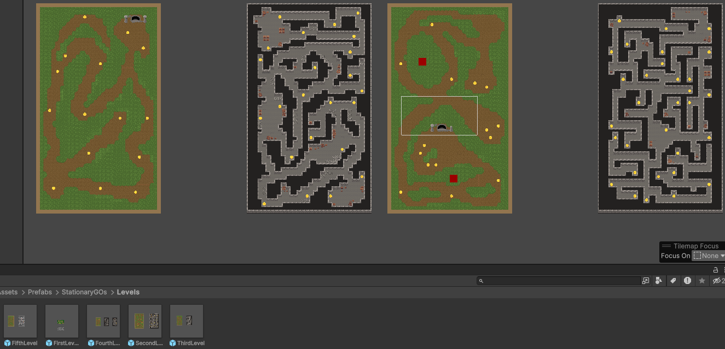
Work Examples

Slide 11
Work Examples

Slide 12
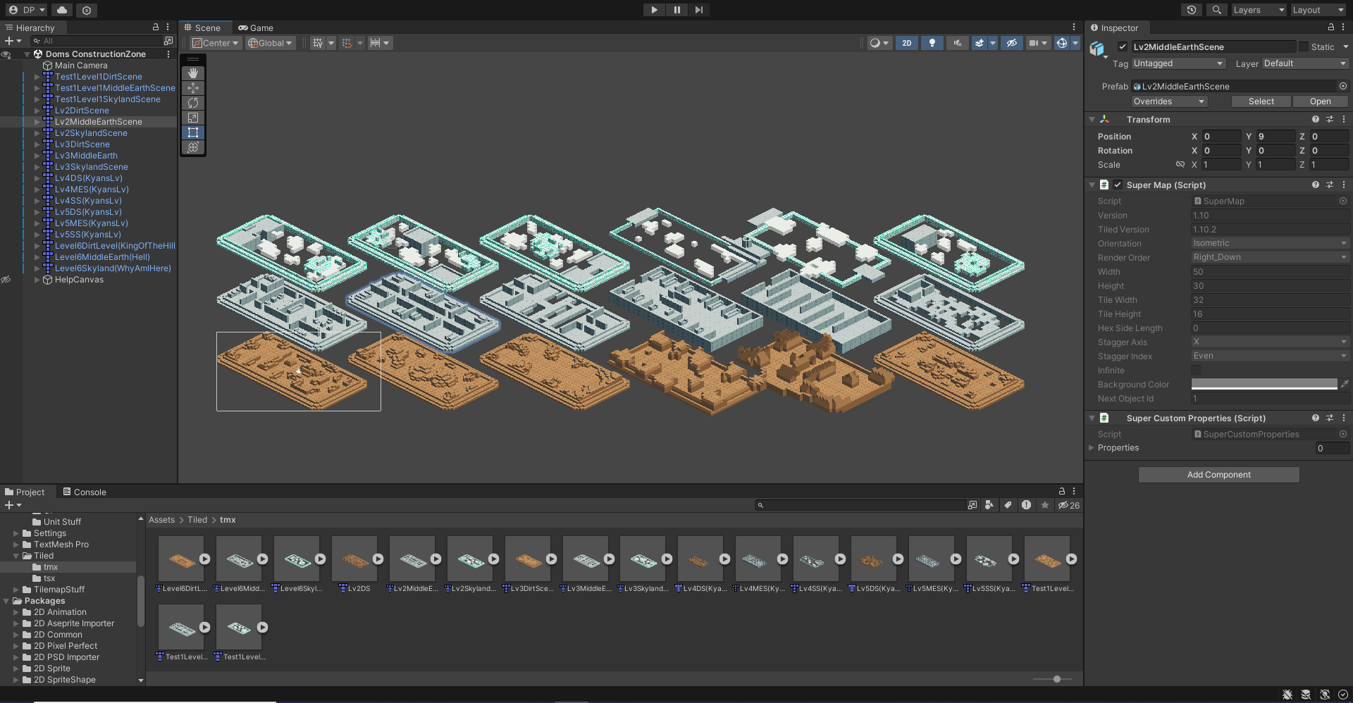
Work Examples

Slide 13
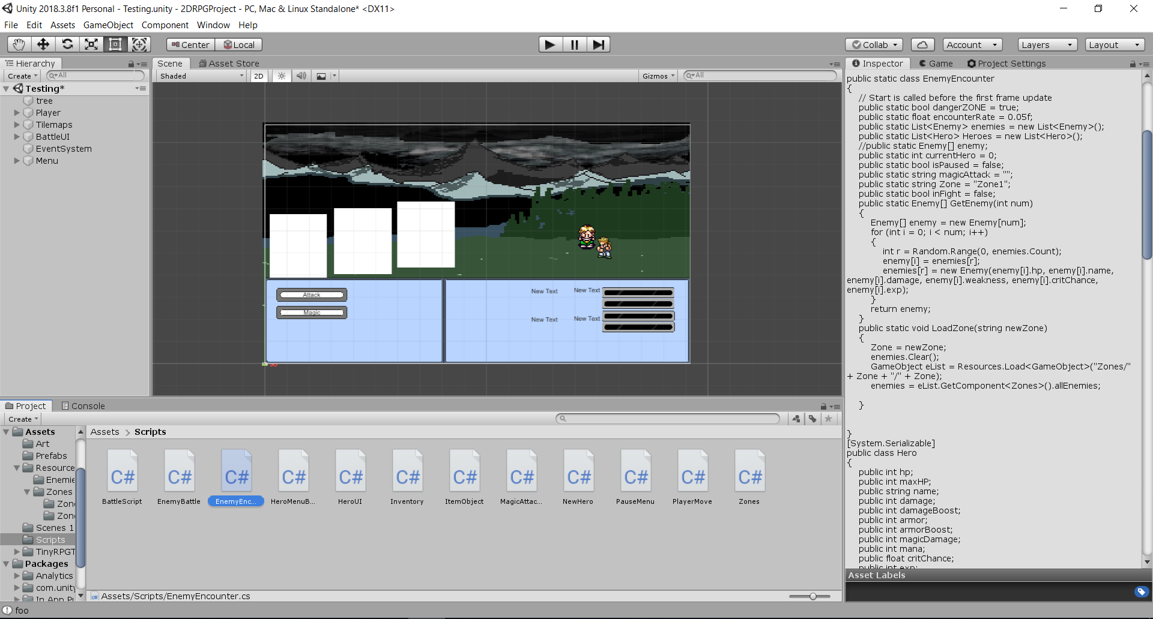
Work Examples

